Slide 1
TraceIt
Revolutionizing Consumer-Producer Market Using Blockchain
Team Members
Priyanshu Verma [19BIT0114]
Yash Singhal [19BIT0136]
Ayush Dwivedi [19BIT0236]
Parth Bhardwaj [19BIT0254]
Pratishtha Gaur [19BCE0104]
Apurv Shewale [19BCE0167]

Slide 2
Work
Division
CEO - Yash
CTO, Developer - Ayush
Product Director, Developer - Priyanshu
Operations - Apurv
CMO, Sales - Pratishtha
CFO - Parth

Slide 3
Problem Statement
Lack of transparency/ traceability with regards to ingredients and origin of products we are consuming on daily basis from a global supply chain

Slide 4
Objective
Using blockchain based Solidity Smart Contracts to store Information in ethereum. Which provides immutable, irreversible and secure data storage.
Help us to trace the disease caused by poultry products back to its source
Ensures quality of the product.

Slide 5
Business Model

Slide 6
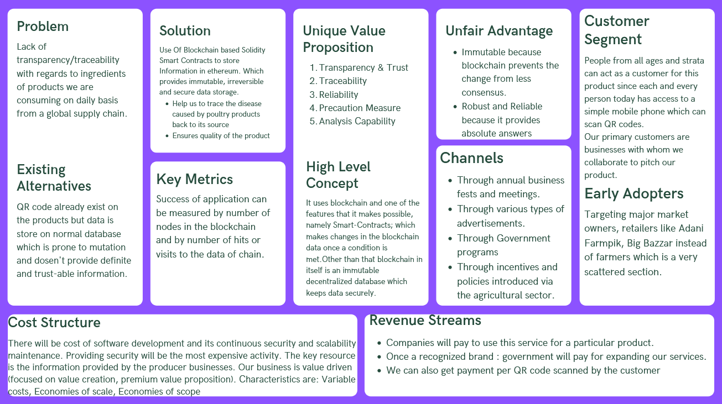

Slide 7
Revenue Model
Our company is a service based startup, so the major part of funding required is in development and marketing stages.
To start with, all the co-founders will be contributing to make a prototype for demonstration purposes to capture the first funding.
The first year will just involve financial struggle and looking for fundings. In year two when the cash concerns will resolve to some extent the focus would be on gathering clients and cracking permanent adopters.
Only from year three can we think about making profit and thinking about making the startup sustainable

Slide 8
Operational Overview
Operations involves mapping of all the resources with the execution process.
The execution process in our case involves tracking of producers to retailers and transporters.
Location of functioning is variable since it depends on the client's business location.
The primary functioning can be done remotely but maintenance require working on site.
Physical space requirement is only for a permanent office place for official meetings planning and strategizing. The operations will have to be handled from the client site.
Production process involves two factors, QR code generation and blockchain data addition and maintenance.
The major labor requirements in this process is not in development aur marketing aspects but operations.
Maintenance is a major concern in blockchain projects.

Slide 9
Sales Model
Sales models-the broker model, the gainsharing model and the commission model.
We use Gainsharing model.
In the gainsharing model, we work directly with the customer to cut costs.
Since we have a very low cost of maintenance and ‘First in the market’ advantage, we plan to be able to provide the our services at a around 70% of the price of most of competitors.
Therefore even after setting a base profit margin of 20%, we will be able to provide our services to the customers at 84% of the price of our competitors.
The other source of income would be advertisements.

Slide 10
Sales And Distribution Channels
Online Marketing
Raise awareness about our presence in the market. Both positive and negative feedbacks will visible all throughout
Business development and cross-sales joint ventures
Find a business partner, typically one larger in size, which has the same customer base and targets a very similar market segment
Referral and affiliate programs
Spread the word about product using affiliate networks to connect demographically-related users to your website. Referral programs can offer customers something in return.
Commercial trade
Shows a great way to write up some orders and educate the consumer about our products

Slide 11
Business Competitors

Slide 12
Competitor | Established Date | Size | Market Share | Value to customers | Strengths | Weakness
Walmart | 1962 | 2.2 million | 35% | Employees can track some products back to their roots | Large resources so can take larger risks | Too much complex processes Hence takes a lot of time
Maersk | 1904 | 80.000 | 3% | Security were all able to remotely access data about the cargo | Best technology integration in market space | Weak presence in India
Udp | 1907 | 50,000 | 2.3% | The group is working to develop blockchain standards for the freight industry. | Small company hence dynamic and new technology is accepted readily | Weak presence in India

Slide 13
Sustainable
The biggest difference-mainly offering B2B services and not B2C services.
The blockchain innovation is a radical, competence-destroying innovation in that the novelty of the technology
By removing the need for middlemen, the Blockchain technology has the potential to completely reshape any industry and in particular the capital markets
The main effect of the innovation is on the consumers resulting in additional peace of mind.
The only pitfalls that can be foreseen are the technological competence of the users with them being able to navigate across the web app in order to buy and access other features that we are offering
Using IPO as exit strategy

Slide 14
SWOT Analysis
Strengths:
Transparency & Trust: Blockchain’s greatest characteristic stems from the fact that its transaction ledger for public addresses is open to viewing.
Better security: Blockchain is far more secure than other record keeping systems because each new transaction is encrypted and linked to the previous transaction.
Traceability: With the blockchain ledger, each time an exchange of goods is recorded on a Blockchain. Can also help verify the authenticity of the traded assets.
Weakness:
Scalability: Blockchains are a decentralized system. Therefore they are not scalable.
Opportunity
Government schemes like IDEA,NRLM,NULM
Threats:
Energy Consumption: Blockchain networks require a large amount of energy to remain operational.

Slide 15
Risk Analysis
Standard risk
One of the most common business risks of the blockchain is the risk of business continuity
Domain specific risk
Possession of the account may be taken over with the aid of using malicious actors. Blockchain is likewise now no longer 100% steady and is susceptible to attacks.
Reputational risk
If not done correctly, it can result in poor customer experience
Cross-border transactions
FINRA, a regulatory agency, wants all dealings in trading securities to follow state laws, regulations and rules. It not only affects companies, but also the core idea of ​​distributed ledger technologies

Slide 16
Thank You

